Slide 1
Applied Imaging Concepts: An introduction to image processing and analysis
Sara Rolfe
8/26/19

Slide 2
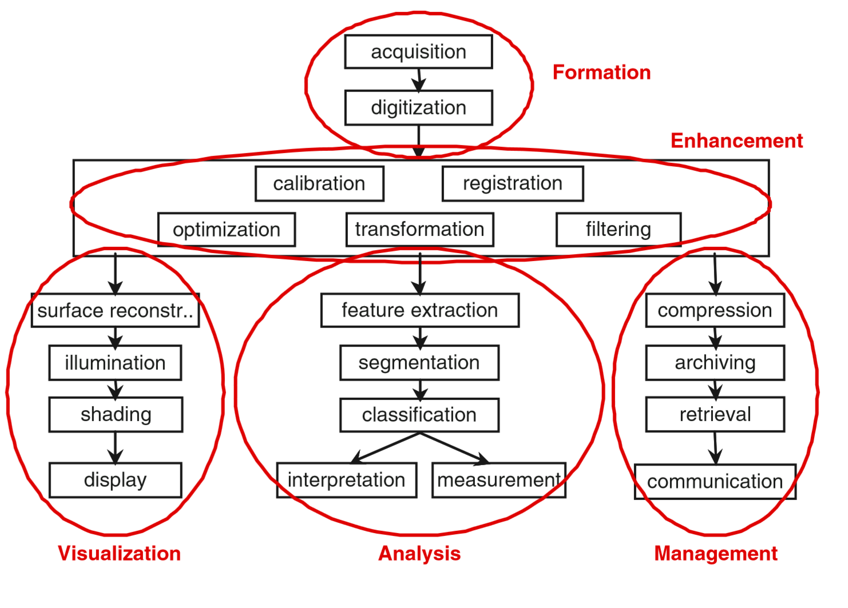
3D imaging conceptual workflow

Slide 3
Outline
Image Formation
Coordinate systems
Digitization and quantization
Resolution
Image Enhancement
Filtering and transformations
Registration
Image Analysis
Segmentation
Image Visualization
Surface reconstruction
Display

Slide 4
What is a Coordinate System?
v₃
A coordinate system for a three-dimensional space is a point O called the origin along with three linearly independent vectors v₁, v₂, and v₃.
Linearly independent here means no two of the vectors are parallel and the three vectors do not all lie in the same plane.
O
v₁
v₂

Slide 5
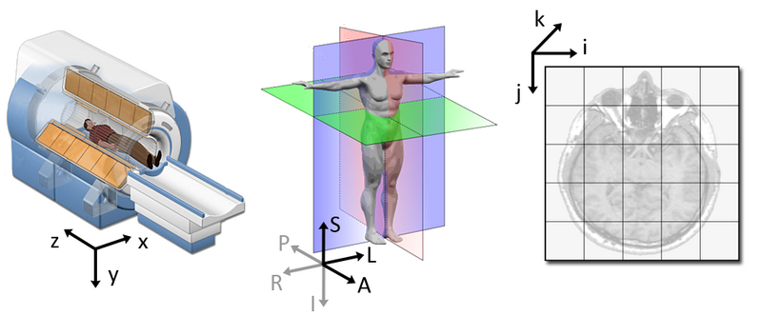
Coordinate Systems
World Coordinate
System
Anatomical Coordinate
System
Image Coordinate
System

Slide 6
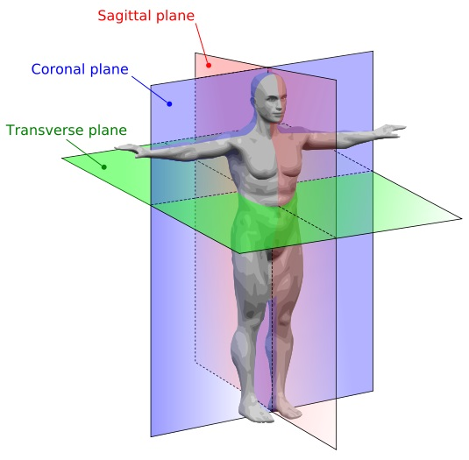
Anatomical coordinate system
This space consists of three planes to describe the standard anatomical position of a human:
axial plane is parallel to the ground and separates the head (Superior) from the feet (Inferior)
coronal plane is perpendicular to the ground and separates the front from (Anterior) the back (Posterior)
sagittal plane separates the Left from the Right
This coordinate system is fixed with respect to the scan table and the object or subject being scanned. Different medical applications use different definitions of this 3D basis

Slide 7
Anatomical coordinate system: RAS vs LPS
Superior
Superior
Anterior
Posterior
Left
Right
Right
Left
Posterior
Anterior
Inferior
Inferior
RAS (Right, Anterior, Superior): 3D Slicer
LPS (Left, Posterior, Superior): DICOM images, ITK toolkit

Slide 8
The IJK Coordinate System
k
Every medical scanner has its own coordinate system called the IJK coordinate system. The
IJK coordinate system represents the actual rectangular prism of data that is scanned, instead of the position of the scan table
j
-i
i
-j
-k

Slide 9
Coordinate System Conversion
We frequently need to convert between
coordinate systems, such as RAS and IJK.
The mapping from one coordinate system to
another is a 3D affine transformation: a
sequence of transformations consisting of a
shear, a reflection, a rotation, a scaling, and a
translation.

Slide 10
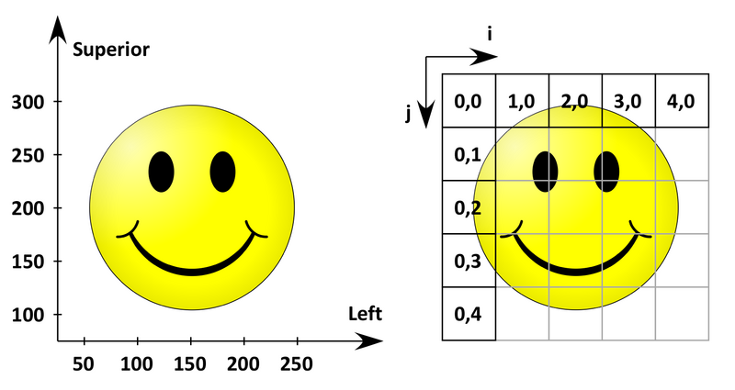
What do all of these mean
LPS Anatomical space
Image Coordinate System

Slide 11
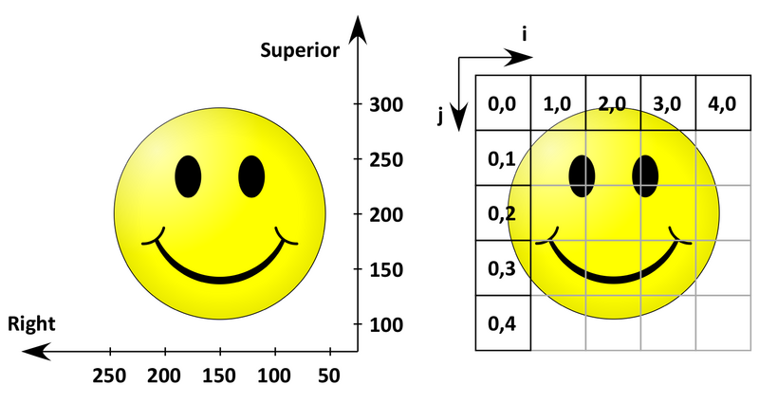
What do all of these mean
RAS Anatomical space
Image Coordinate System

Slide 12
What do all of these mean
KNOW YOUR DATA AND SOFTWARE
RAS Anatomical space
Image Coordinate System

Slide 13
What is an image?
An image is a sampling of a continuous field using a discrete grid

Slide 14
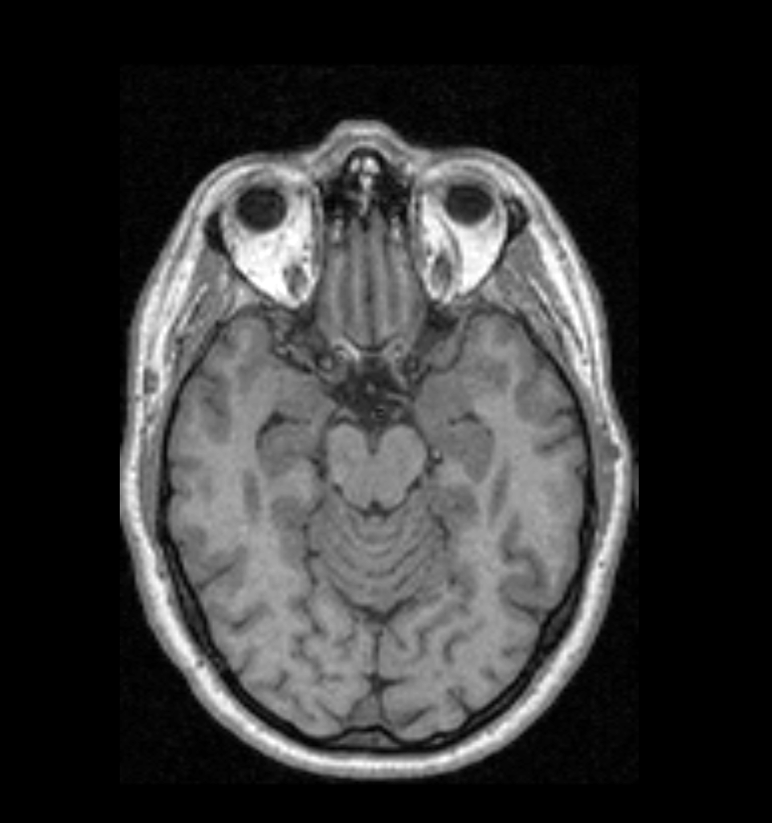
What is an image?
Spacing (x)
Spacing (y)
Origin (x,y)

Slide 15
What is an image?
Spacing (x)
Pixel Index
[0,7]
[4,7]
[0,5]
[0,3]
Spacing (y)
[0,1]
Origin (x,y)
[0,0]
[1,0]
[2,0]
[3,0]
[4,0]
[5,0]

Slide 16
Digitization
Digital image processing implies the discrete nature of images.
Values in an image are samples on a pixel (2D) or voxel matrix (3D)
Digitization applies to both sampling (resolution) and the value range (quantification)

Slide 17
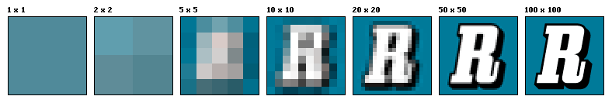
Resolution
Resolution is the capability of sensor to observe or measure the smallest object clearly with distinct boundaries. MicroCT scanners have resolutions from sub-micron range to 100s of microns (1000 micron = 1 mm).
Pixel is unit of digital image. How big of a physical structure a pixel represents depends on the resolution (i.e. resolution and pixel size are inversely proportional).

Slide 18
Resolution in 3D
Similar to pixel, voxel is a unit of digital volume:
Resolution in each dimension is not necessarily identical: That’s especially true for human imaging, where the sampling in Z is a lot coarser than X and Y (i.e. they take far fewer slices, but within a slice you see everything you need to see in high-detail). In this case the voxels are said to be ANISOTROPIC. If all dimensions are identical then the voxels are ISOTROPIC

Slide 19
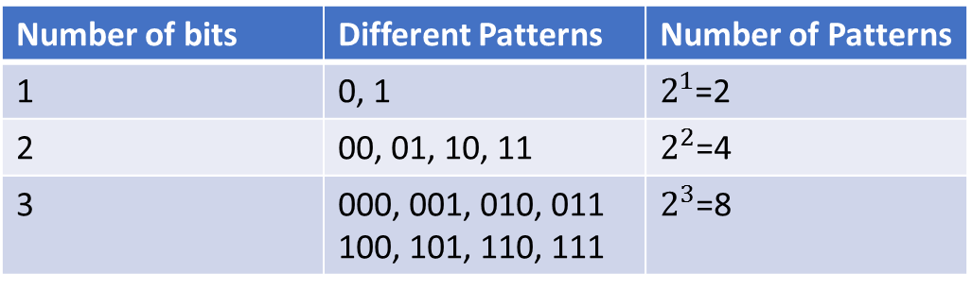
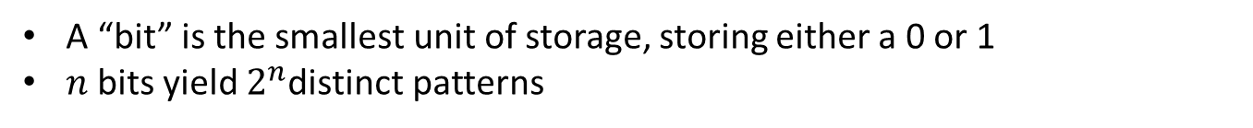
Bits and Bytes
A “bit” is the smallest unit of storage, storing either a 0 or 1
$n$bits yield $2^{n}$distinct patterns
Number of bits | Different Patterns | Number of Patterns
1 | 0, 1 | $2^{1}$=2
2 | 00, 01, 10, 11 | $2^{2}$=4
3 | 000, 001, 010, 011 100, 101, 110, 111 | $2^{3}$=8
One byte = collection of 8 bits
All storage is measured in bytes
Kilobyte, KB, ~ 1 thousand bytes
Megabyte, MB, ~ 1 million bytes
Gigabyte, GB, ~ 1 billion bytes
Terabyte, TB, ~ 1 trillion bytes

Slide 20
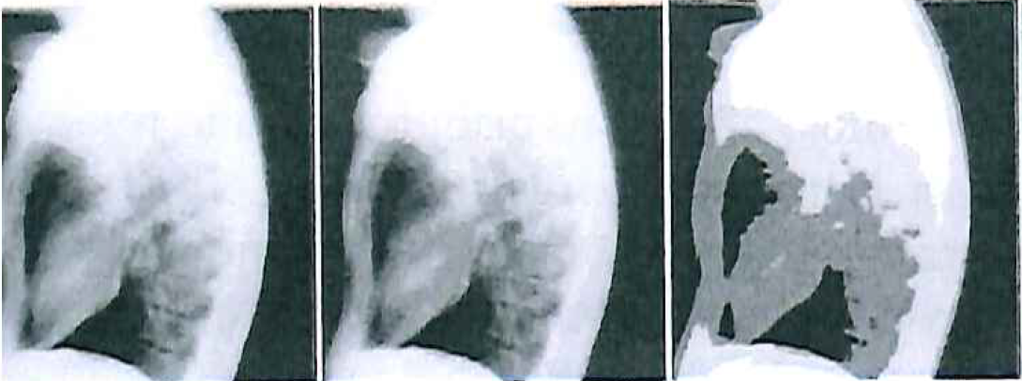
Quantization
Quantization refers to the digitization of the value range
Grayscale image: 8 bits (256 possible states)
Color image: 24 bits (16,777,216 possible states)
CT scans: 12 bits (4,096 possible states)
6 bit (64 values)
3 bit (8 values)
2 bit (4 values)
Notes:
Lateral chest radiograph shown with 6 bit, 3 bit, and 2 bit quantization, which translates to 64, 8 and 4 grayscale values.

Slide 21
Quantization and image size
You have a CT scan of a human subject that is 256 pixels wide, 256 pixels high, and consists of 256 slices and the image depth is 16 bit.
How big is this data set?

Slide 22
Quantization and image size
You have a CT scan of a human subject that is 256 pixels wide, 256 pixels high, and consists of 256 slices and the image depth is 16 bit.
How big is this data set?
8 bit = 1 byte
256 x 256 x 256 x (16/8) = 33,554,432 Bytes
~ 32MB

Slide 23
Image enhancement
Image enhancements are low-level operations that are preformed without knowledge of the content of an image
Why?
Remove noise
Sharpen image, etc.
Examples
Histogram transformations
Convolution
Mathematical morphology
Registration

Slide 24
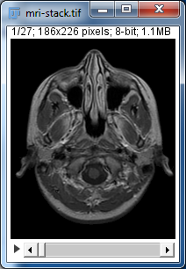
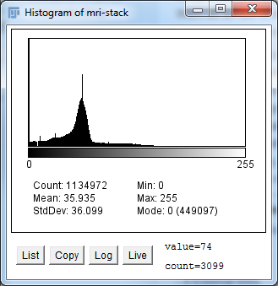
Image Histogram
An image histogram shows the frequency distribution of the pixel values (in this context grayscale) in a digital image. It plots the number of pixels for each tonal value.

Slide 25
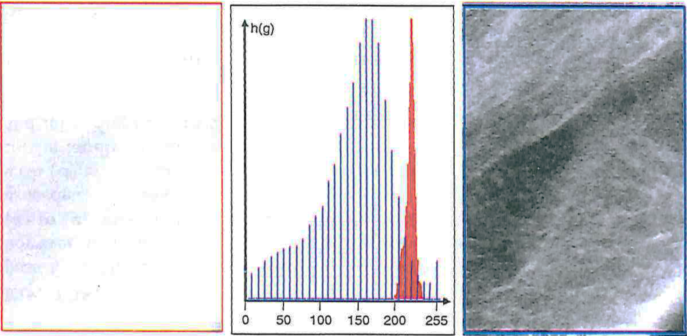
Histogram transformation
Simple pixel transforms can be defined using the histogram
In this example the gray scale values of the image in (A) are stretched, resulting in the improved contrast in (C)
A. Original image
B. Original and stretched histograms
C. Enhanced image

Slide 26
Image filtering
Modify the intensity values of a pixel based on a function of the intensity values from a local neighborhood around that pixel.
4
2
8
Function f(x)
4
36
41
19
1
31
44

Slide 27
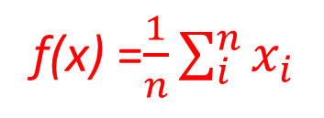
Image filtering
Modify the intensity values of a pixel based on a function of the intensity values from a local neighborhood around that pixel.
4
2
8
Function f(x)
4
36
41
19
1
31
44
f(x) =$\frac{1}{n}\sum_{i}^{n}{x_{i}}$
Mean filtering/ moving average
Removes sharp features

Slide 28
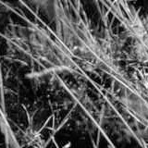
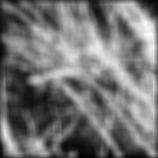
Smoothing with a mean filter

Slide 29
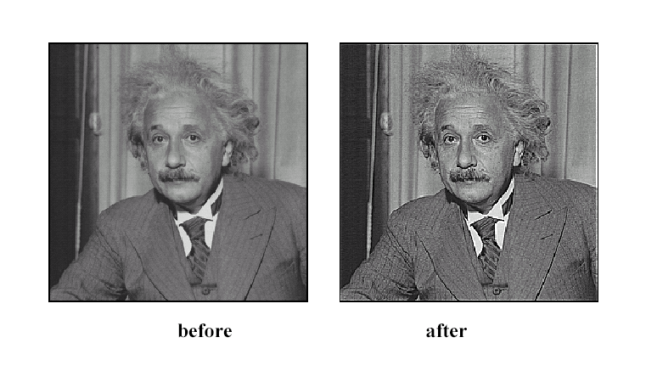

Sharpening
Sharpening function g(x) = 2x-f(x),
f(x) =$\frac{1}{n}\sum_{i}^{n}{x_{i}}$

Slide 30
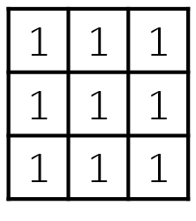
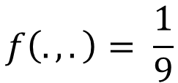
Convolution
Replace each pixel with a linear combination of pixels in local neighborhood
The weights are determined by the filter’s kernel and determine the effect of the filter
The kernel is shifted to each pixel location
From the previous mean filter example, the kernel is:
$$f\left(.,.\right)= \frac{1}{9}$$

Slide 31
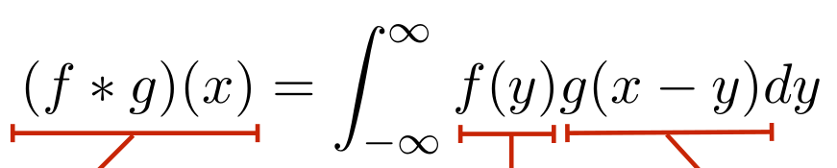
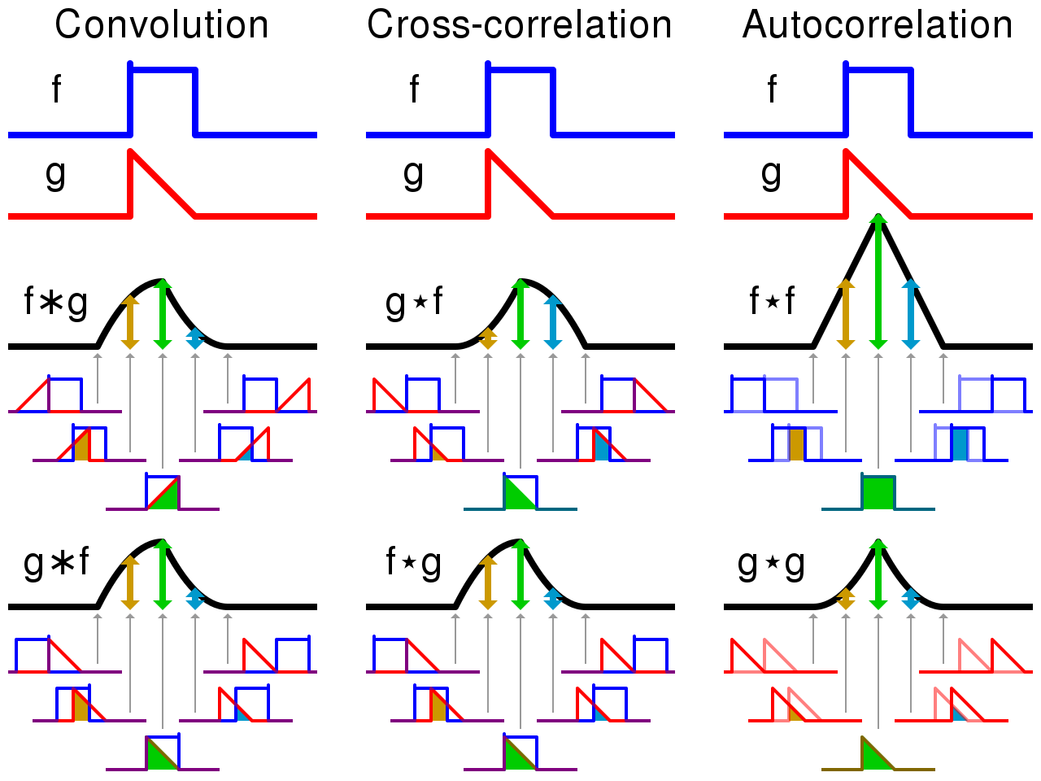
Convolution in 1D
notice the flip
filtered signal
input signal
filter

Slide 32
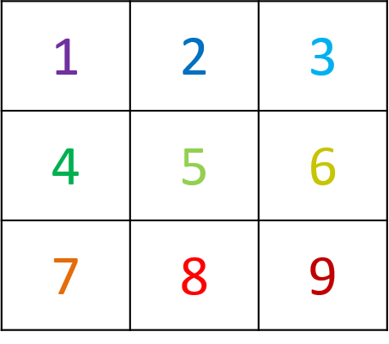
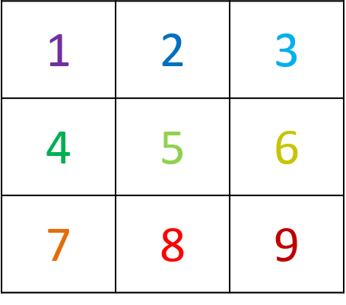
Convolution in 2D
w
f
1*9 + 2*8 + 3*7 + 4*6 + 5*5 + 6*4 + 7*3 + 8*2 + 9*1

Slide 33
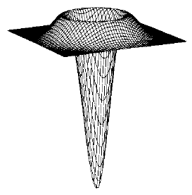

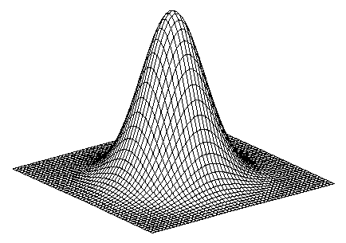
Other common kernel choices
1
2
1
Sobel
0
1
0
Vertical Gradient
Horizontal Edge
(absolute value)
0
0
0
0
0
0
-1
-2
-1
0
-1
0
0
0
0
Horizontal Gradient
0
1
0
LaPlacian of Gaussian
2D edge detection
-1
0
1
1
-4
1
0
0
0
0
1
0
Gaussian smoothing
Weight contribution by nearness

Slide 34
Mathematical morphology
Set of logical operations performed primarily on binary images
Frequently used to clean up shapes after pixel–based segmentation
Binary mathematical morphology consists of two basic operations
Dilation: based on logical AND
Erosion: based on logical OR
and several composite relations
Closing: dilation followed by erosion
Opening: erosion followed by dilation
Skeleton: erosion with various structuring elements

Slide 35
Structuring Elements
A structuring element is a shape mask used in
the basic morphological operations.
They can be any shape and size that is
digitally representable, and each has an origin.
box
hexagon
disk
other

Slide 36
Dilation
Dilation expands the connected sets of 1s of a binary image.
It can be used for
1. growing features
2. filling holes and gaps

Slide 37
Erosion
Erosion shrinks the connected sets of 1s of a binary image.
It can be used for
1. shrinking features
2. Removing bridges, branches and small protrusions

Slide 38
Image Registration
Registration can be used to obtain a correspondence between images such that a change in measured dimensions can be quantified.
The moving image will be resampled into the fixed image coordinate system
y
y’
y
x
Space Transform
x
x’
Physical coordinates of fixed image
Physical coordinates of moving image
The space transformation can be rigid or non-rigid (more on this later)

Slide 39
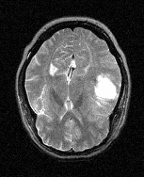
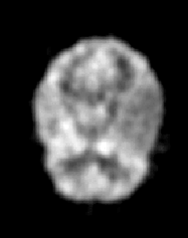
Multimodal registration
MRI-T2
PET
Space Transform
128 x 128 pixels
256 x 256 pixels
Images from the project: “Retrospective Image Registration Evaluation”, NIH, Project No. 8R01EB002124-03, Principal Investigator, J. Michael Fitzpatrick, Vanderbilt University, Nashville, TN.

Slide 40
Multimodal registration
MRI-T2
PET
Transform
128 x 128 pixels
Do not register images in pixel space
Pixel spacing needs to be specified
256 x 256 pixels
Images from the project: “Retrospective Image Registration Evaluation”, NIH, Project No. 8R01EB002124-03, Principal Investigator, J. Michael Fitzpatrick, Vanderbilt University, Nashville, TN.

Slide 41
Image Analysis

Slide 42
Segmentation
Dividing an image into connected regions based on the content of the image
Regions of an image segmentation should be uniform and homogenous with respect to some characteristic, such as gray tone, color or texture and should differ significantly with respect to adjacent regions
Techniques include
Thresholding
Grow from seeds
Watershed filter
Fast marching filter

Slide 43
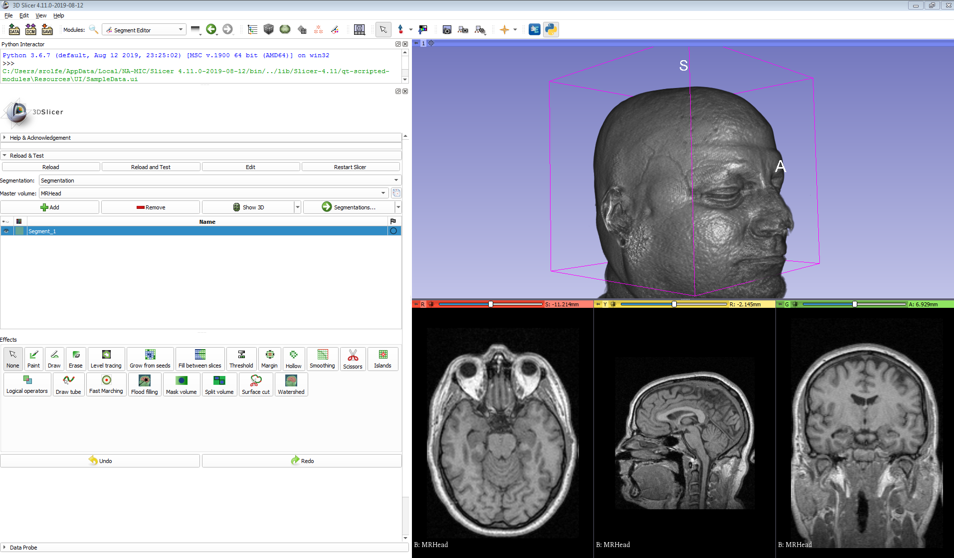
Segmentation tools available in 3D Slicer

Slide 44
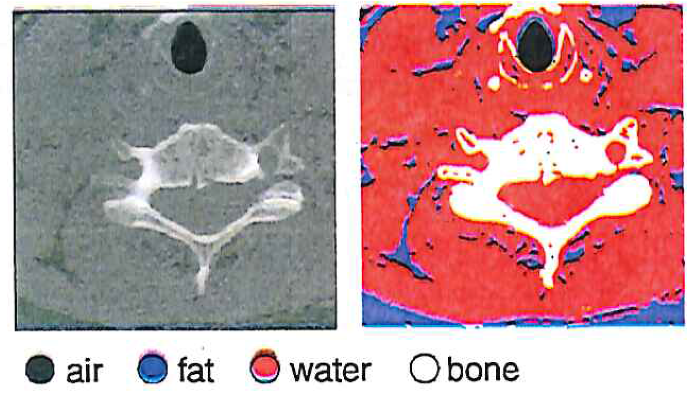
Thresholding
Assigning labels to pixel intensity ranges
Can be static or dynamic
Static: known value ranges for types of tissue in CT scans
Segmentation in CT relying on Hounsfield Units (HU) which define a window of values for each tissue type

Slide 45
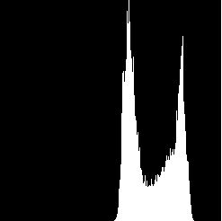
Histogram-Directed Thresholding
How can we use a histogram to separate an
image into 2 (or several) different regions?
pixel
counts
0
256
gray-tone values
Is there a single clear threshold? 2? 3?

Slide 46
Automatic Thresholding: Otsu’s Method
Grp 1 Grp 2
Assumption: the histogram is bimodal
Method: find the threshold t that minimizes
the weighted sum of within-group variances
for the two groups that result from separating
the gray tones at value t.
Note: In practice, this operator works very well for true bimodal
distributions and not too badly for others.

Slide 47
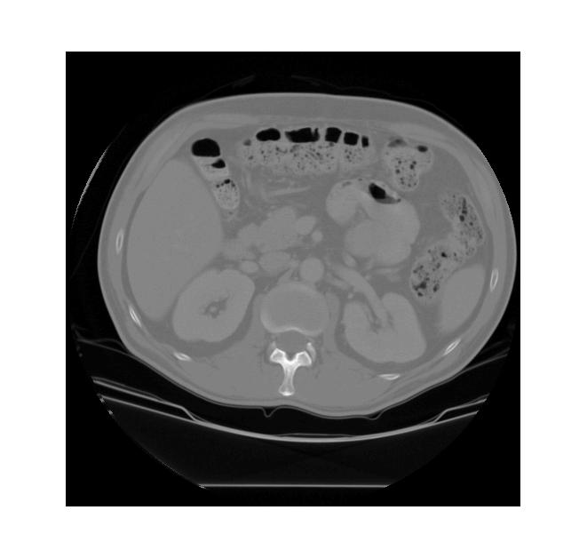
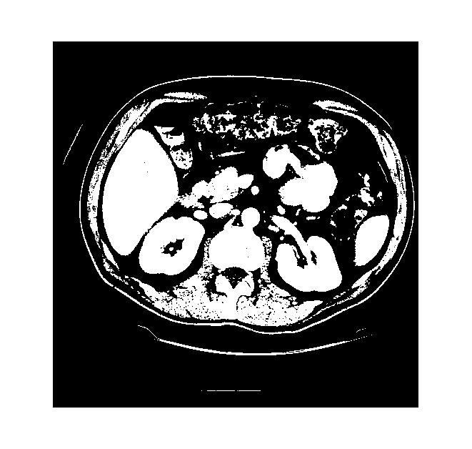
Thresholding Example
original gray tone image
binary thresholded image

Slide 48


Connected Components Labeling
Identify and then analyze each connected set of pixels.
The connected components operation takes in a binary image and produces a labeled image in which each pixel has the integer label of either the background (0) or a component.
original grayscale image
binary image after threshold applied
binary image after morphology
connected components

Slide 49
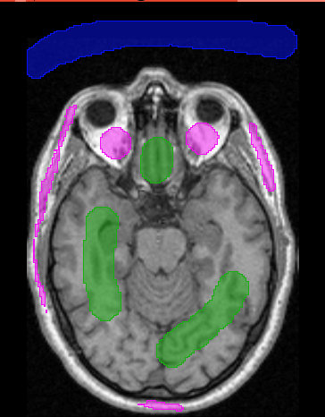
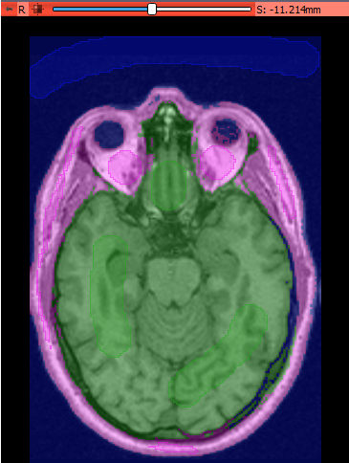
Grow from seeds
Region growing techniques start with one pixel of a potential region and try to grow it by adding adjacent pixels till the pixels being compared are too dissimilar
Can include a priori knowledge of the scene by taking a set of seed pixels can be chosen from the image
A statistical tests used to decide which pixels can be added to a region
User provided seeds
Segmentation grown from seeds

Slide 50
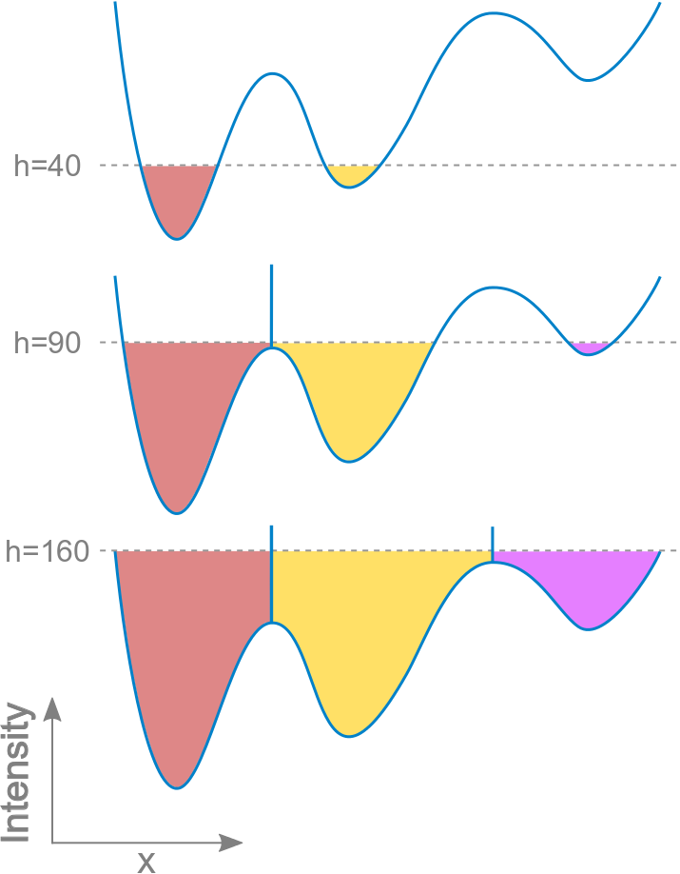
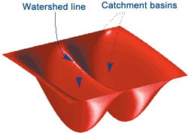
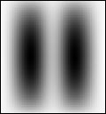
Watershed filtering
The watershed transform treats a 2D image like a surface
Catchment basins are identified at regional minimums
The basins are “flooded” until the different water sources meet, determining the watershed lines between regions
Gray scale image
Image visualized as a surface where bright areas are “high” and dark are “low”
Progressive watershed “flooding” in 1D

Slide 51
Fast marching filter

Slide 52
Surface reconstruction

Slide 53
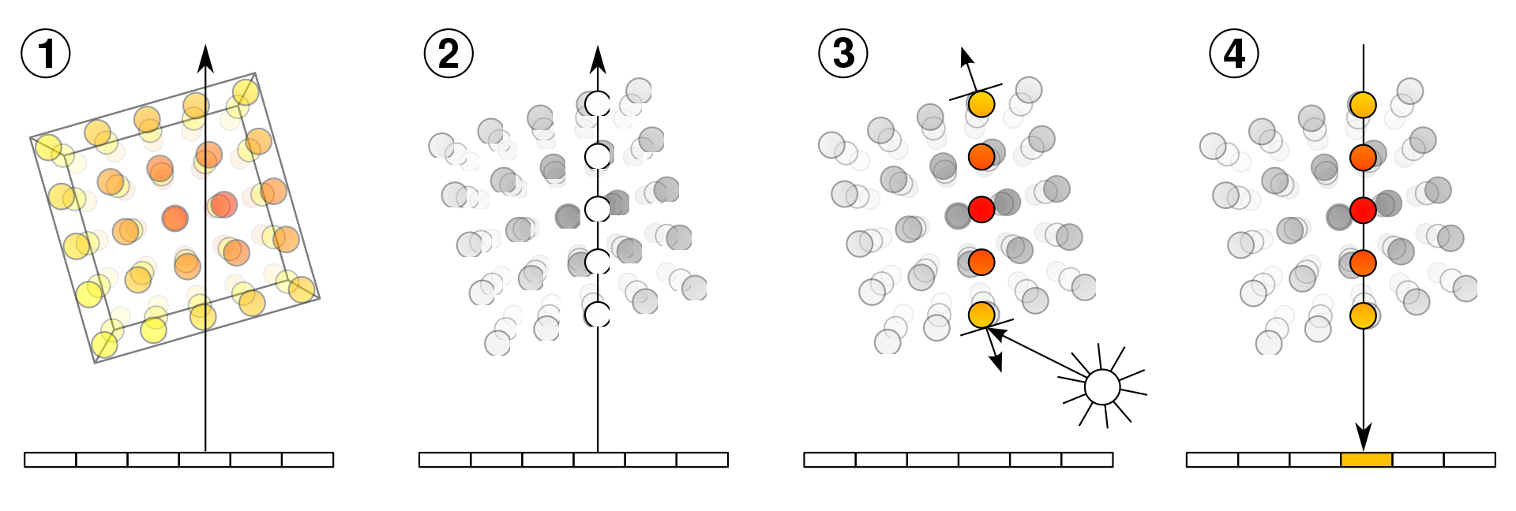
Volume rendering: Ray casting
Direct volume visualization does not rely on a preliminary calculation of the object surface or segmentation
Visualization based directly on voxel data
1. Volume is processed along an imaginary light ray
Parameters are extracted from voxel intensity along the rays and
A transfer function is applied that incorporates material properties and illumination
The final value is applied as color or gray values at the corresponding position on the viewing plane

Slide 54
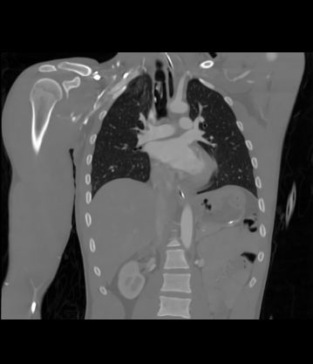
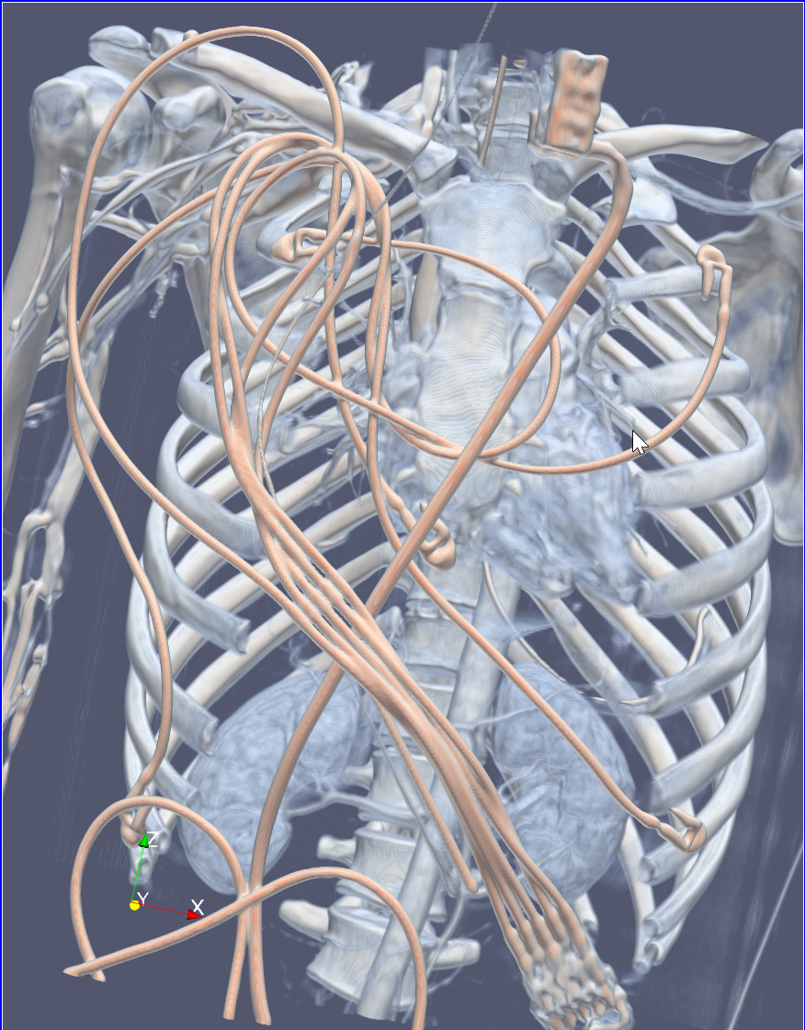
GPU Ray casting
Coronal slice of 3D CTA image
3D volume rendering using ray casting

Slide 55
Questions?

